Slide 1
WEB PROJECT
PIZZA SHOP

Slide 2
THE TEAM
NGUYỄN THANH HẢI
17110025
1
ĐỖ NGUYỄN HOÀNG HẢI
17110024
2

Slide 3
TABLE OF CONTENTS
Project Overview
01
03
ERD
Diagram
02
04
Use Case
Work Assignment

Slide 4
PROJECT
OVERVIEW
01

Slide 5
MAJOR REQUIREMENTS
SYSTEM OBJECT MANAGEMENT
PUBLIC PAGE
USER AUTHENTICATION
USER
MANAGEMENT,
AUTHENTICATION

Slide 6
PROJECT STAGES
STEP 2
STEP 1
STEP 3
Implement
Code
Define Requirements
Design Database
Design UI
Validation

Slide 7
WHAT WE ARE WORKING ON
System
Object
Management
Public
Page
Login
Page

Slide 8
USE CASE
02

Slide 9
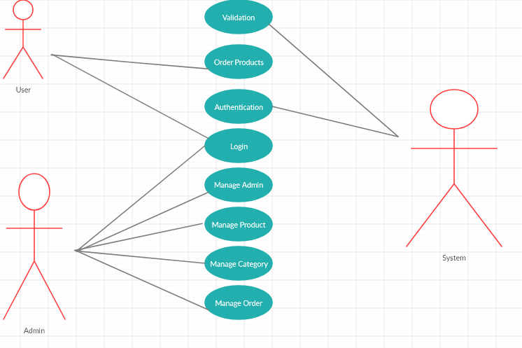

Slide 10
ERD
DIAGRAM
03

Slide 11
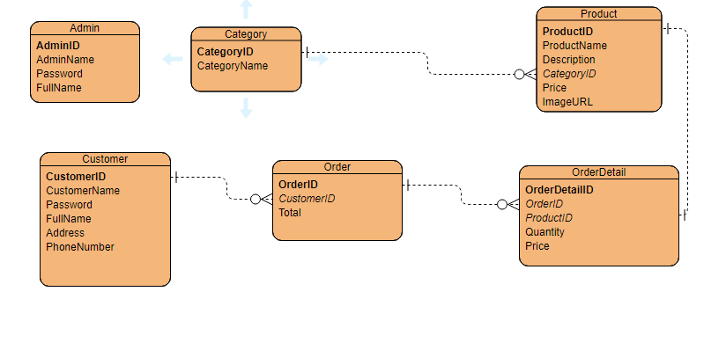
ERD DIAGRAM

Slide 12
WORK
ASSIGNMENT
04

Slide 13
OUR TIMELINE
WEEK 1
WEEK 3
NEW
PROJECT
FINAL
VERSION
WEEK 2
WEEK 4
Define Requirements
Implement & Coding
Design UI Database
Improve UI Testing

Slide 14
THANKS!

